Slide 1

pROJECT DATA Analysis for Property Services
Priti Gurav (Lead BI Developer)

Slide 2

Agenda
Introduction & Data Assumptions
Project Overview& Financials
Quality & Client Satisfaction
Sustainability & Workforce
Recommendations & conclusion Questions

Slide 3


Introduction & Data Assumptions:
The goal of this presentation is to showcase the insights derived from project data and provide strategic recommendations to support business decision-making.
walk you through the key highlights from the dashboard, identifying trends, challenges, and opportunities that can drive business performance forward.
Actual amounts provided for few contracts has been converted to % to align with rest of divisions
The post codes for NW1 , NW2 and South London has been set to NW1 , NW2 and SE respectively
Contract types are treated as NA wherever not provided

Slide 4

Dashboard Design Overview
Project Overview & Financials
Quality & Client Satisfaction
Sustainability & Workforce Metrics
Data Extracts

Slide 5
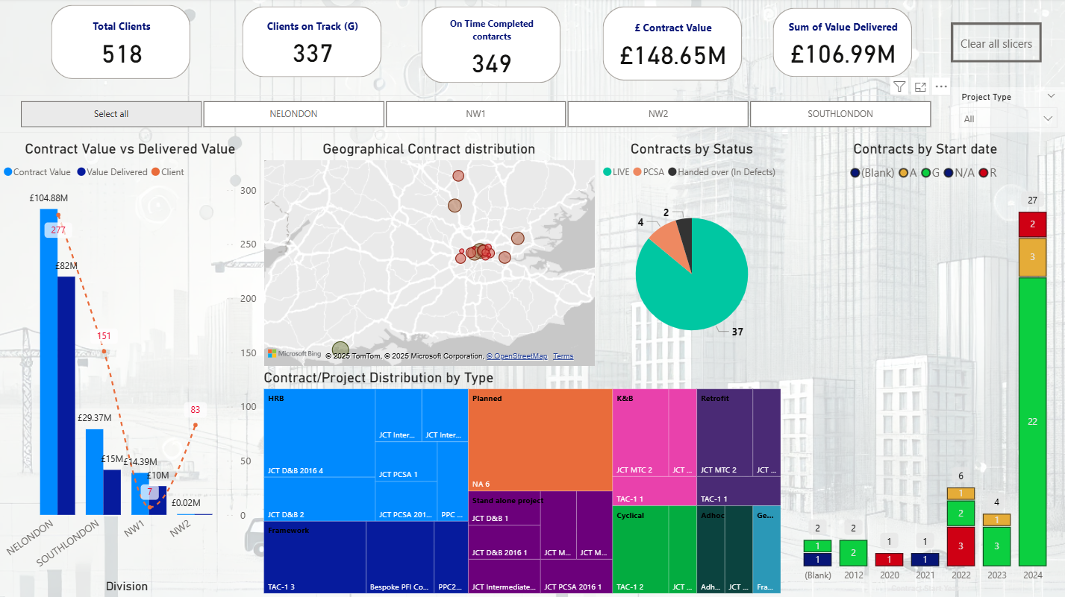

Dasboard design Overview
Project Overview & Financials
Quality & Client Satisfaction
Sustainability & Workforce Metrics
Data Extracts

Slide 6
Business currently manages 518 clients, with 337 on track total contract value is £148.65M, while the sum of value delivered stands at £106.99M geographical contract distribution highlights a strong presence in key regions divided across different types, with some underperforming and others exceeding expected values

Slide 7
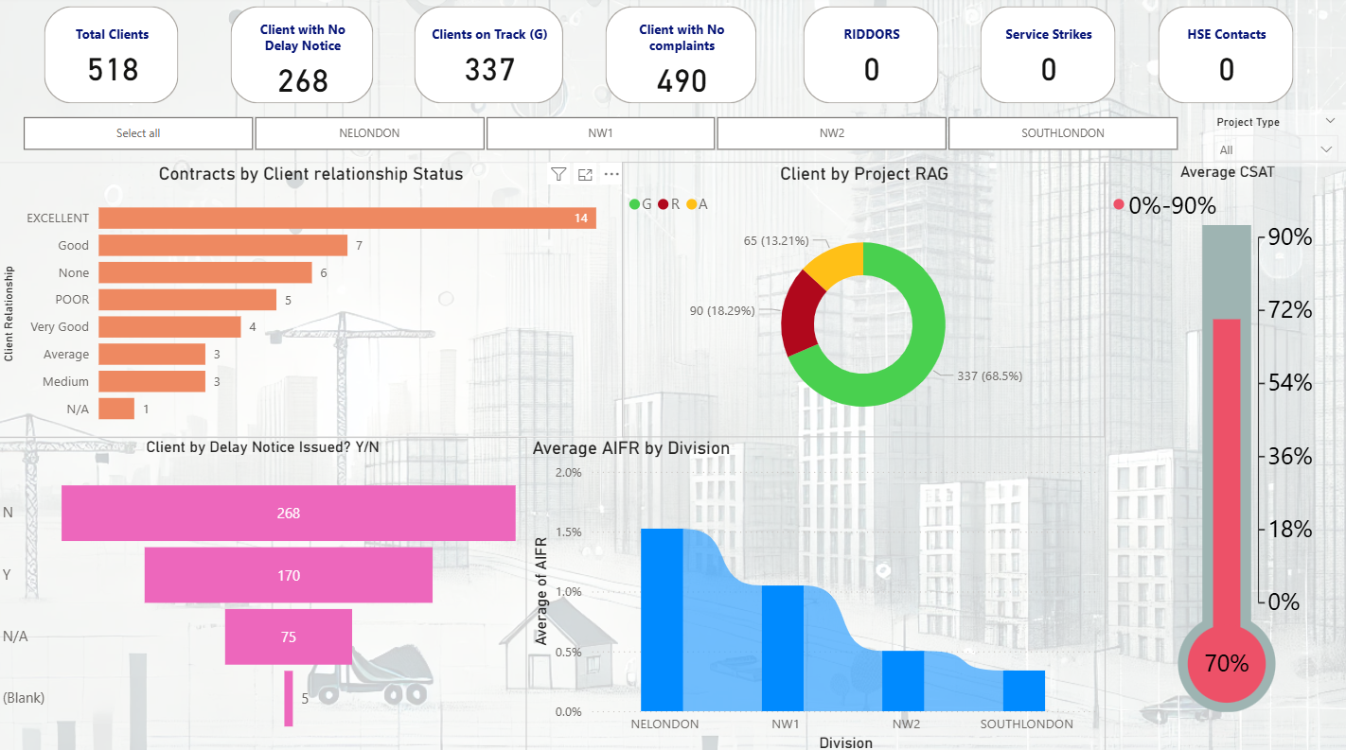
United Living currently manages 518 clients, with 337 on track total contract value is £148.65M, while the sum of value delivered stands at £106.99M geographical contract distribution highlights a strong presence in key regions divided across different types, with some underperforming and others exceeding expected values

Slide 8
268 clients have had no delay notices – a positive indicator
337 clients (68.5%) have a "Green" Project RAG status, suggesting a majority of projects are on track
CSAT (Customer Satisfaction Score) is at 70% – indicating good performance but with room for improvement.
Some clients have rated their relationship as "Poor", which needs further investigation

Slide 9
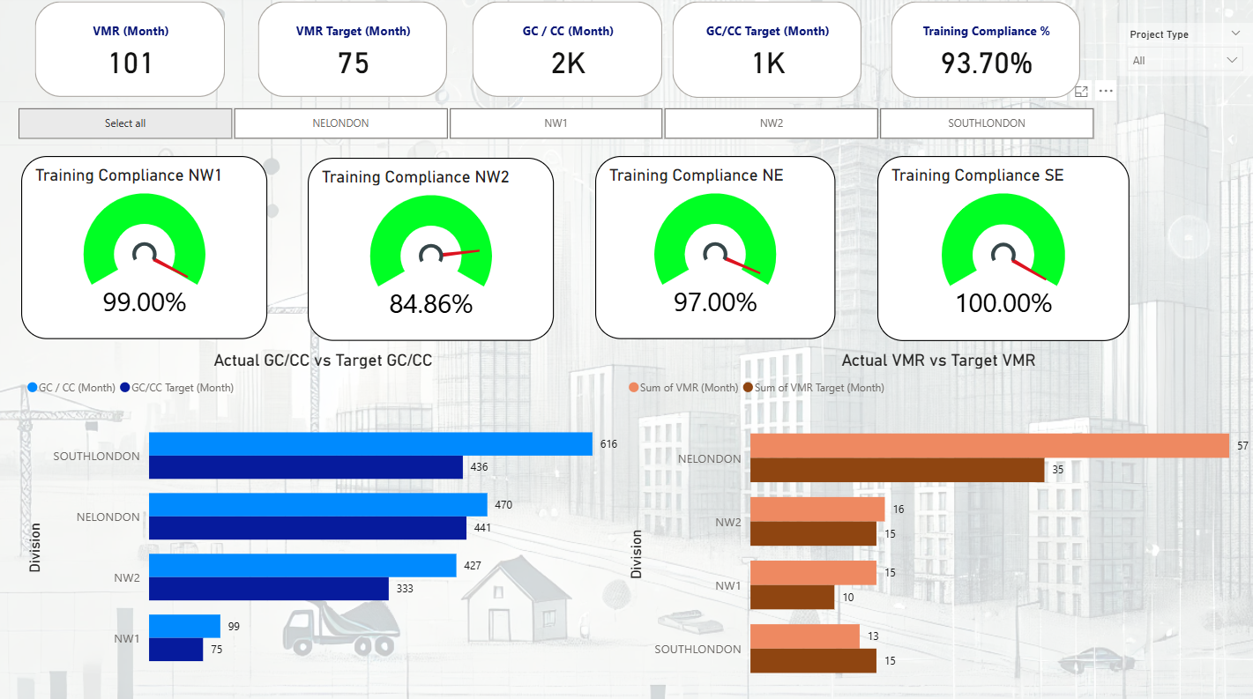

Slide 10
Training compliance across divisions is high, with SE achieving 100%, and NW1 at 99%
Actual vs Target workforce efficiency shows a positive trend – most regions are meeting or exceeding targets.
GC/CC (General Contractor vs. Contract Compliance) performance is strong, indicating operational efficiency.

Slide 11

Recommendations:
Financial performance can be improved by closing the gap between contract value and delivered value.
Customer satisfaction, while strong, requires targeted efforts to address lower-rated relationships.
Workforce efficiency and training compliance are performing well, but standardization is necessary.
Data-driven decision-making is key to optimizing project execution and financial forecasting.
Enhance project execution efficiency –Reduce Delays and improve delivery rates

Slide 12


THANK YOU
Priti Gurav
priti26497@gmail.com

